Slide 1
KEYBOARD/DISPLAY CONTROLLER - INTEL 8279

Slide 2
Features of 8279
The important features of 8279 are,
Simultaneous keyboard and display operations.
Scanned keyboard mode.
Scanned sensor mode.
8-character keyboard FIFO.
1 6-character display.
Right or left entry 1 6-byte display RAM.
Programmable scan timing.

Slide 3
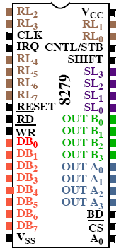
Pin details
A0: Selects data (0) or control/status (1) for reads and writes between micro and 8279.
Output that blanks the displays.
CLK: Used internally for timing. Max is 3 MHz.
CN/ST: Control/strobe, connected to the control key on the keyboard.
Chip select that enables programming, reading the keyboard, etc.
 DB7-DB0: Consists of bi-directional pins that connect to data bus on micro.

Slide 4

Pin details
IRQ: Interrupt request, becomes 1 when a key is pressed, data is available.
OUT A3-A0/B3-B0: Outputs that sends data to the most significant/least significant nibble of display.
IRQ: Interrupt request, becomes 1 when a key is pressed, data is available.
OUT A3-A0/B3-B0: Outputs that sends data to the most significant/least significant nibble of display.
: Connects to micro's IORC or RD signal, reads data/status registers.
RESET: Connects to system RESET.
RL7-RL0: Return lines are inputs used to sense key depression in the keyboard matrix.
Shift: Shift connects to Shift key on keyboard.
SL3-SL0: Scan line outputs scan both the keyboard and displays.
: Connects to micro's IORC or RD signal, reads data/status registers.
RESET: Connects to system RESET.
RL7-RL0: Return lines are inputs used to sense key depression in the keyboard matrix.
Shift: Shift connects to Shift key on keyboard.
SL3-SL0: Scan line outputs scan both the keyboard and displays.

Slide 5
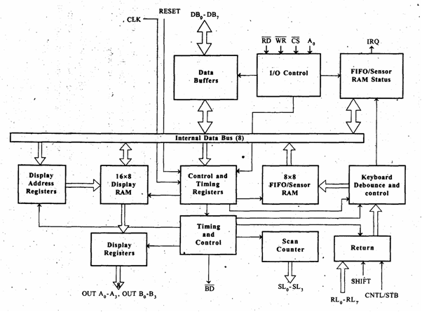
Block diagram of 8279

Slide 6
Sections
Keyboard
Display
Scan
CPU interface

Slide 7
Keyboard section
The keyboard section consists of eight return lines RL0 - RL7 that can be used to form the columns of a keyboard matrix.
It has two additional input : shift and control/strobe. The keys are automatically debounced.
The two operating modes of keyboard section are 2-key lockout and N-key rollover.
In the 2-key lockout mode, if two keys are pressed simultaneously, only the first key is recognized.
In the N-key rollover mode simultaneous keys are recognized and their codes are stored in FIFO.
The keyboard section also have an 8 x 8 FIFO (First In First Out) RAM.
The FIFO can store eight key codes in the scan keyboard mode. The status of the shift key and control key are also stored along with key code.
The 8279 generate an interrupt signal when there is an entry in FIFO.

Slide 8
Display section
The display section has eight output lines divided into two groups A0-A3 and B0-B3.
The output lines can be used either as a single group of eight lines or as two groups of four lines, in conjunction with the scan lines for a multiplexed display.
The output lines are connected to the anodes through driver transistor in case of common cathode 7-segment LEDs.
The cathodes are connected to scan lines through driver transistors.
The display can be blanked by BD (low) line.
The display section consists of 16 x 8 display RAM. The CPU can read from or write into any location of the display RAM.

Slide 9
Scan section
The scan section has a scan counter and four scan lines, SL0 to SL3.
In decoded scan mode, the output of scan lines will be similar to a 2-to-4 decoder.
In encoded scan mode, the output of scan lines will be binary count, and so an external decoder should be used to convert the binary count to decoded output.
The scan lines are common for keyboard and display.
The scan lines are used to form the rows of a matrix keyboard and also connected to digit drivers of a multiplexed display, to turn ON/OFF.

Slide 10
CPU interface section
The CPU interface section takes care of data transfer between 8279 and the processor.
This section has eight bidirectional data lines DB0 to DB7 for data transfer between 8279 and CPU.
It requires two internal address A =0 for selecting data buffer and A = 1 for selecting control register of8279.
The control signals WR (low), RD (low), CS (low) and A0 are used for read/write to 8279.
It has an interrupt request line IRQ, for interrupt driven data transfer with processor.
The 8279 require an internal clock frequency of 100 kHz. This can be obtained by dividing the input clock by an internal prescaler.
The RESET signal sets the 8279 in 16-character display with two -key lockout keyboard modes.

Slide 11
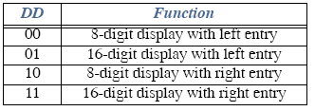
Control Word Description:
First three bits given below select one of 8 control registers (opcode).
000DDMMM
Mode set: Opcode 000.
DD sets displays mode.
MMM sets keyboard mode.
DD field selects either:
8- or 16-digit display
Whether new data are entered to the rightmost or leftmost display position.

Slide 12
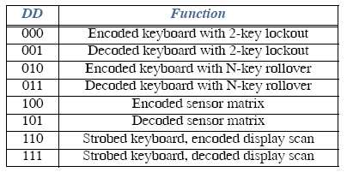
Control Word Description:
MMM field:
MMM
Encoded Mode: SL outputs are active-high, follow binary bit pattern 0-7 or 0-15 depending on 8 or 16 digit display.
Decoded Mode: SL outputs are active-low (only one of the four outputs will be low at any time).Pattern output: 1110, 1101, 1011, 0111.

Slide 13
I/O Interface
Control Word Description:
Strobe : An active high pulse on the CN/ST input pin strobes data from the RL pins into an internal FIFO for reading by micro later.
2-key lockout/N-key rollover: Prevents 2 keys from being recognized if pressed simultaneously/Accepts all keys pressed from 1st to last.

Slide 14
Write display format
 100ZAAAA
write display Selects address – to write address of one of the
Display. Z selects auto-increment so subsequent writes go to subsequent display positions.

Slide 15
Clear Display format
1100CCFA
The clear control word clears the display, FIFO or both
Bit F clears FIFO and the display RAM status, and sets address pointer to 000.
If CC are 00 or 01, all display RAM locations become 00000000.
If CC is 10, --> 00100000,
if CC is 11, --> 11111111.

Slide 16
